Slide 1
Domain Name System Forensics
Traffic files: https://github.com/frankwxu/digital-forensics-lab/tree/main/Networking_Forensics/lab_files/dns
Notes:
https://www.youtube.com/watch?v=6G3qm60dfA8&ab_channel=PrashantThombre

Slide 2
Domain Name System (DNS)
Domain
(google.com)
Motivation: Every device is identified by an IP address, which is a unique numerical identifier.
Problem: However, IP addresses can be difficult for people to remember and use.
Solution
Each device has a domain name (human-readable string). Each domain name corresponds to an IP address
DNS translates domain names into IP addresses and vice versa.
DNS
IP
(216.58.194.174)
Notes:
https://kinsta.com/knowledgebase/what-is-dns/

Slide 3
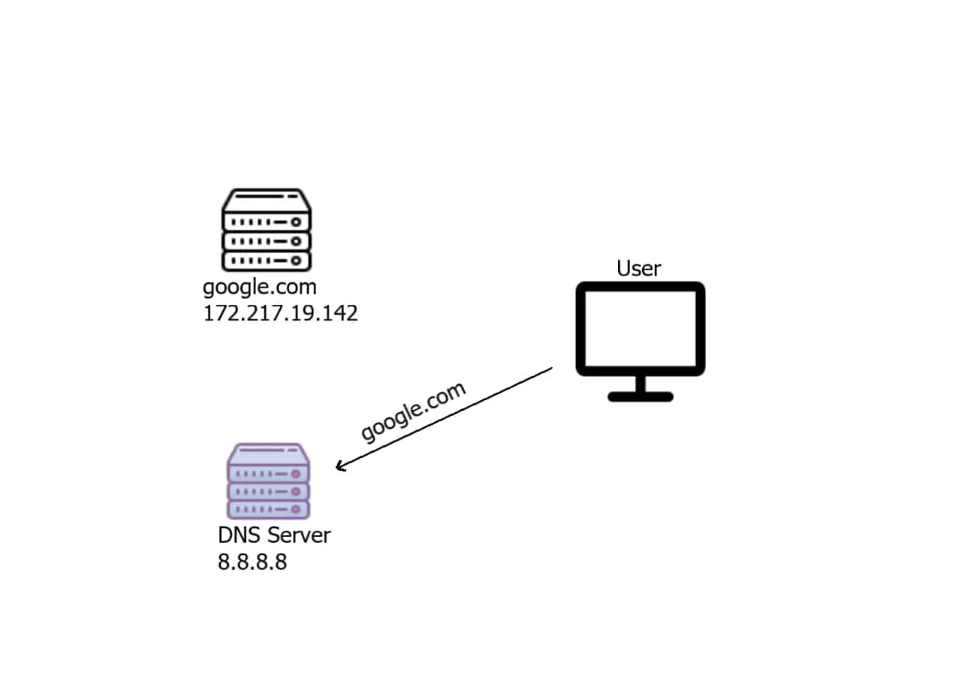
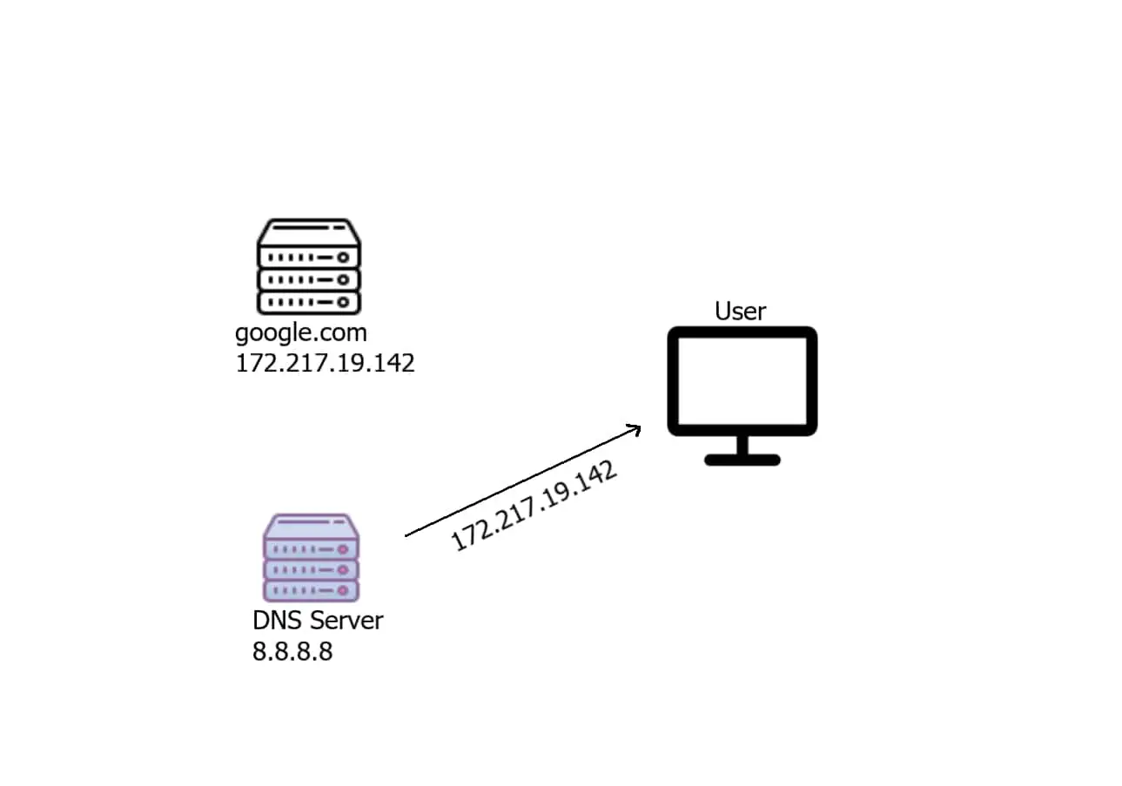
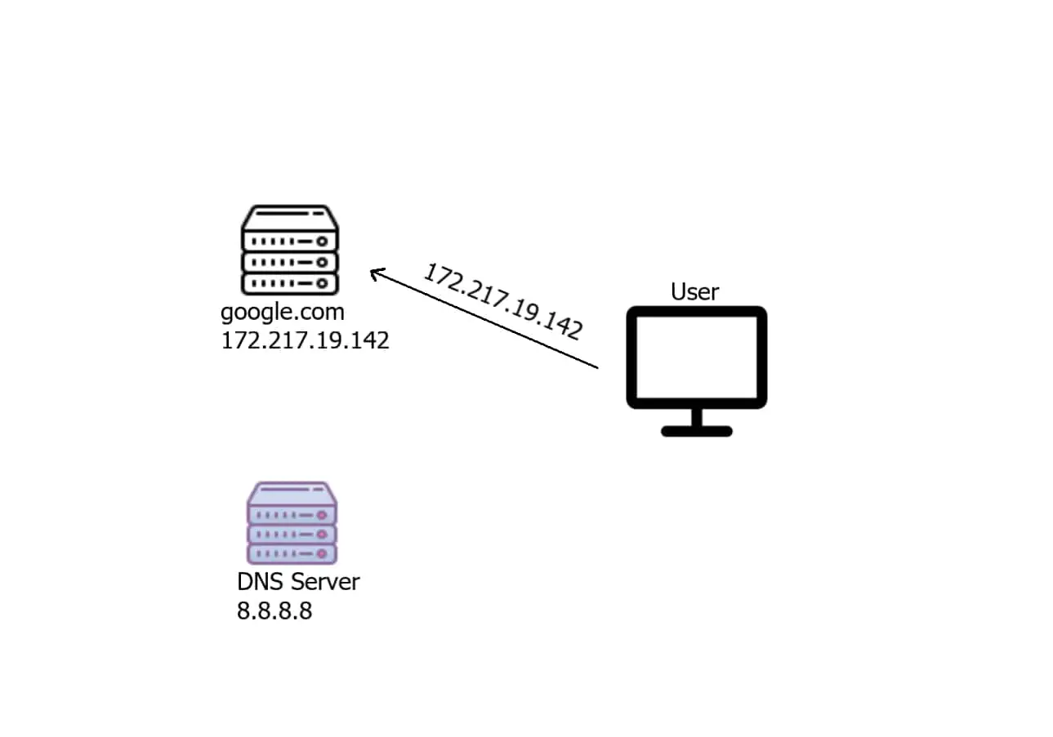
1. What is the IP of google.com?
2. Here is the IP of google.com
3. Now User can talk to google.com
Notes:
https://www.thepythoncode.com/article/make-dns-spoof-python

Slide 4
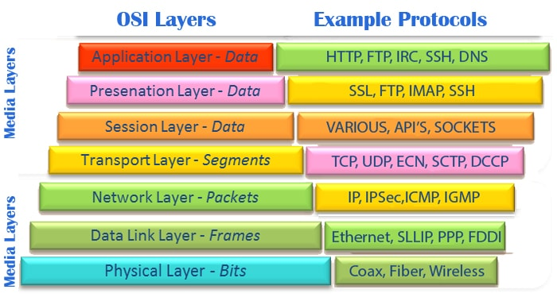
https://asmed.com/comptia-network-osi-model/

Slide 5
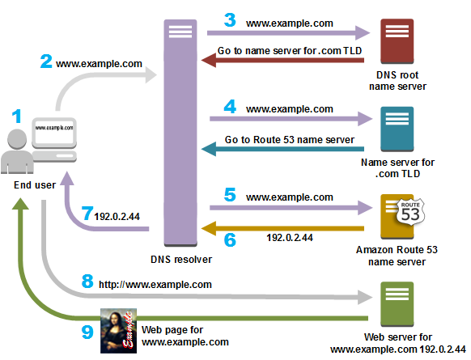
DNS is a hierarchical decentralized system
DNS resolver is often managed by the user's Internet service provide
TLD: top-level domain, such .com, org
https://aws.amazon.com/route53/what-is-dns/

Slide 6
Observe DNS with dig

Slide 7
dig
It is a network administration tool used in Linux and other Unix-based operating systems to perform DNS (Domain Name System) queries.
retrieve information about DNS records, including
IP addresses associated with domain names,
mail server information, and
other DNS-related information.
It sends a query to a specified DNS server and returns the response in a human-readable format.
It can be used to troubleshoot DNS issues, test DNS configuration changes, and gather information about DNS servers.

Slide 8
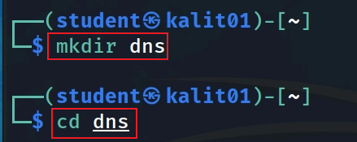

Slide 9
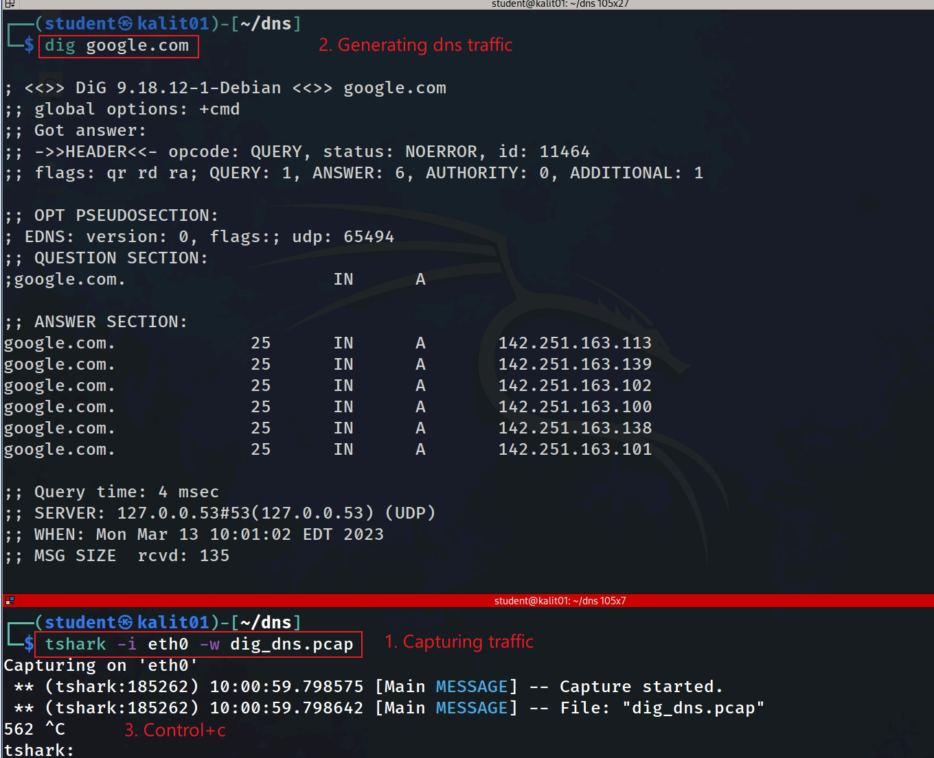
Notes:
tshark -i eth0 -w dig_dns.pcap

Slide 10
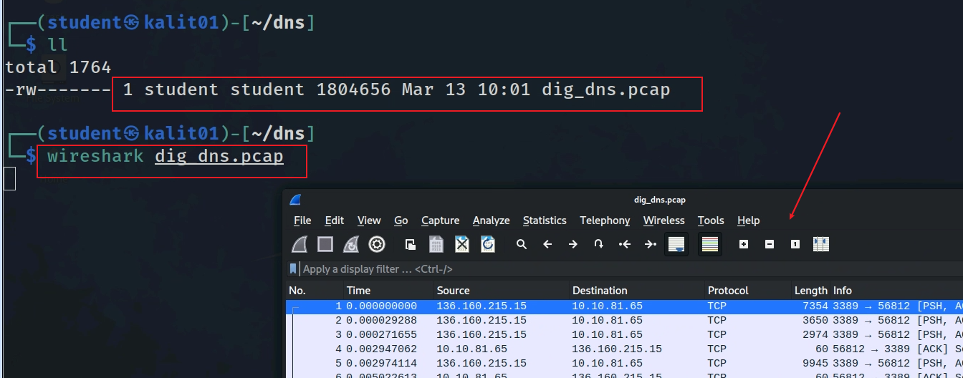
View captured DNS traffic

Slide 11
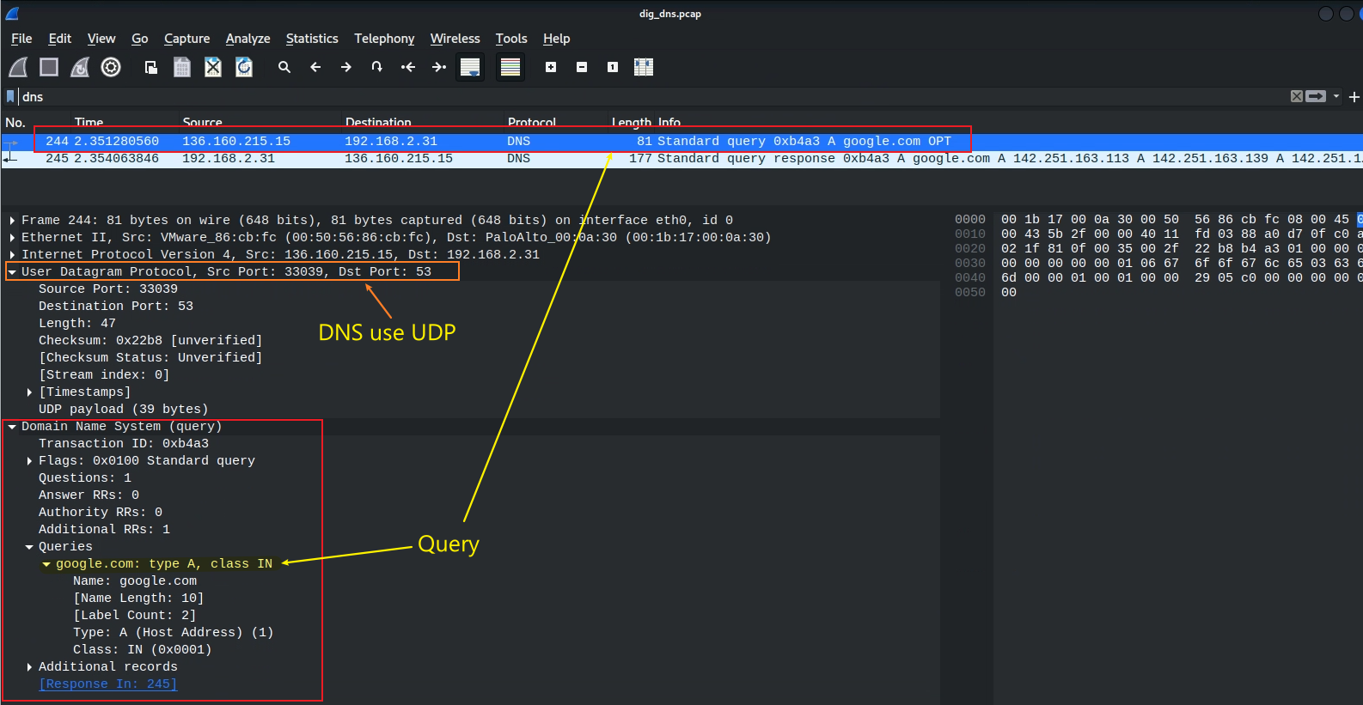
View layers DNS/UDP/IP/Frame of DNS query
dns filter

Slide 12
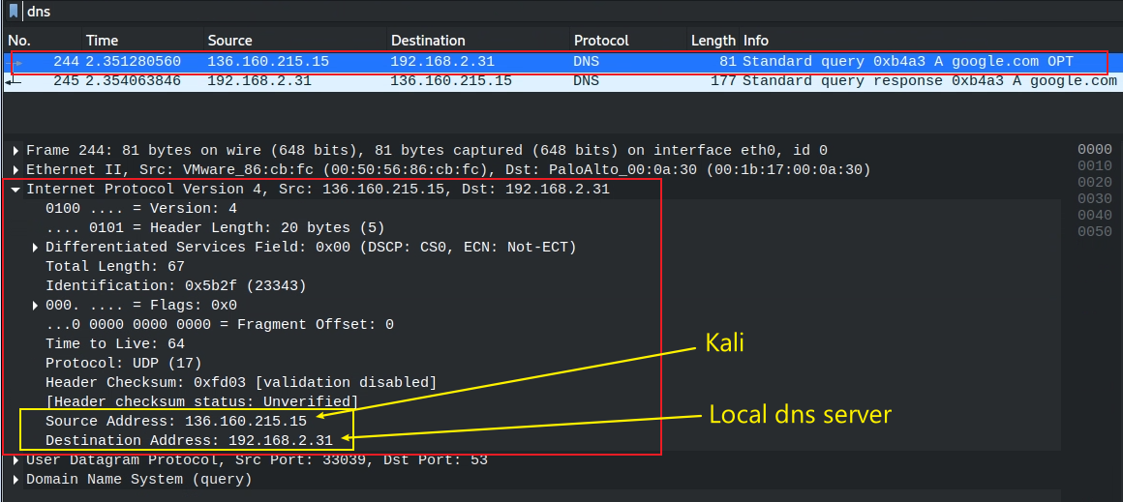

Slide 13
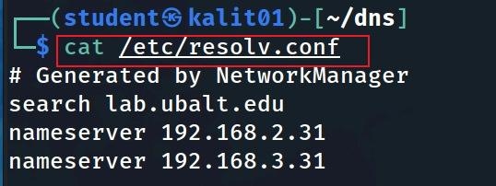
Local DNS configuration file
lists the DNS servers that your system is using for name resolution.
match DNS traffic

Slide 14
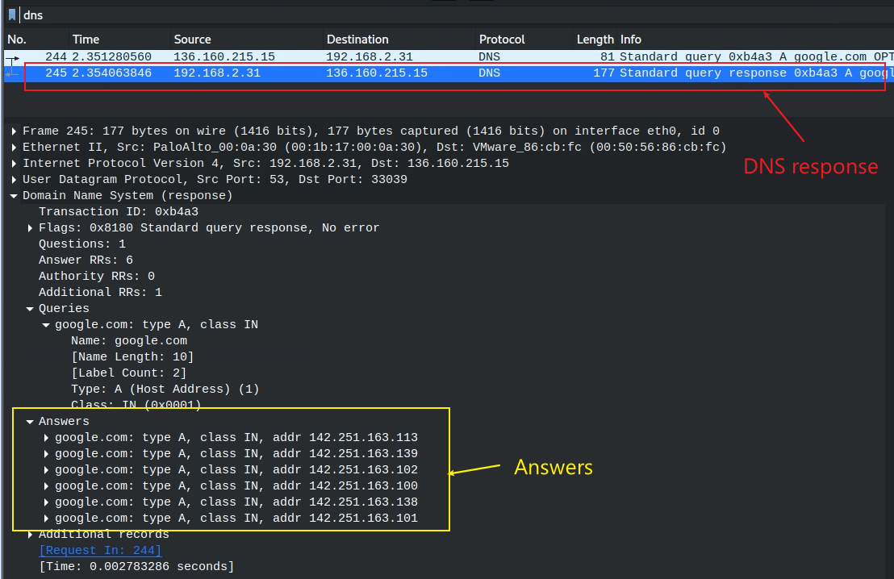
DNS response

Slide 15
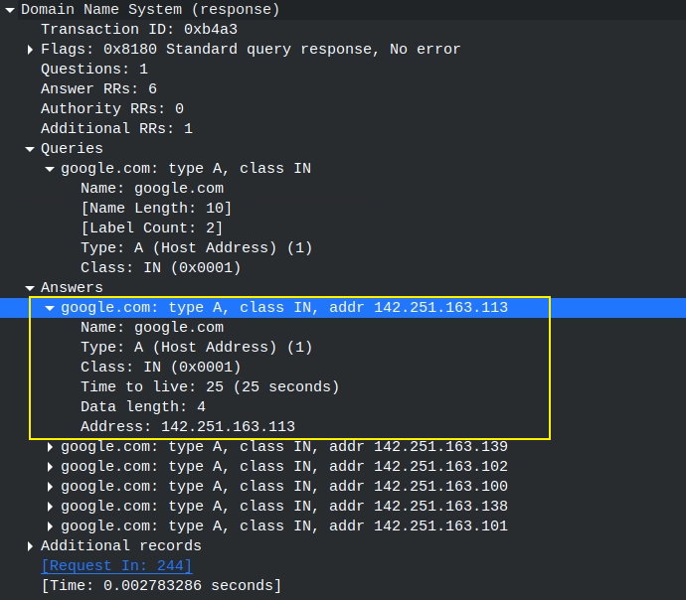
One of answers
maps the domain name to an IP address.
refers to the Internet class.

Slide 16
Observe the DNS traffic of accessing google.com

Slide 17
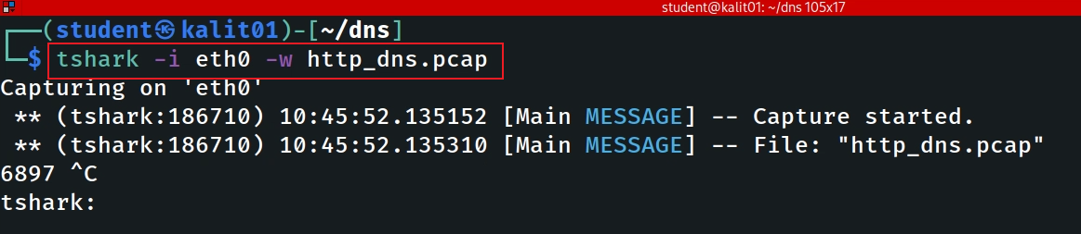
Command to capture traffic
Notes:
tshark -i eth0 -w http_dns.pcap

Slide 18
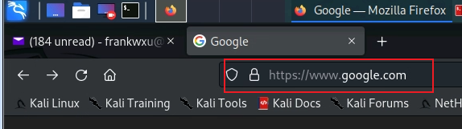
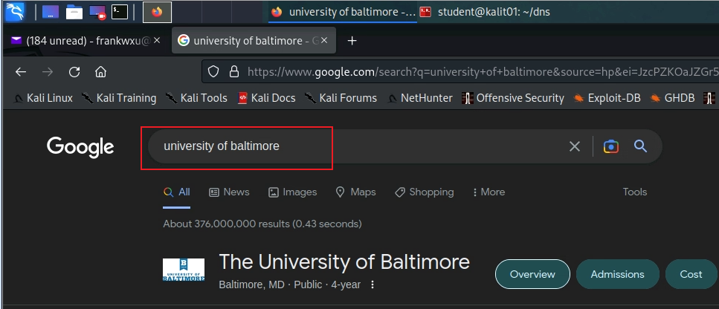
Accessing google.com and google search

Slide 19
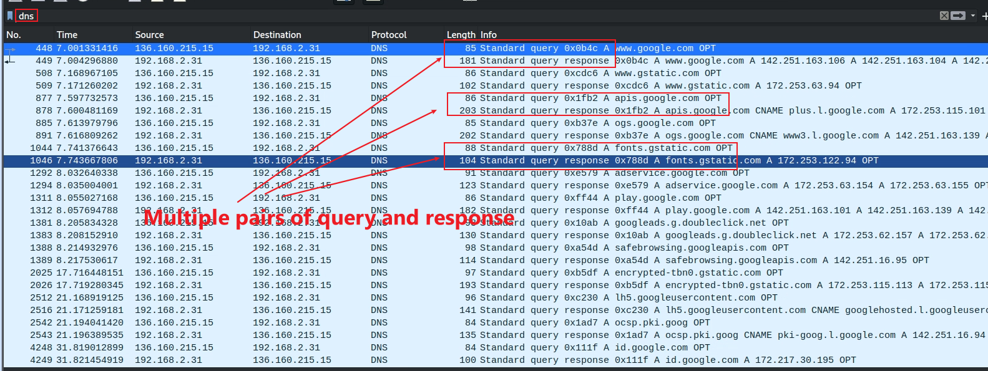
Multiple pairs of DNS query and response because Google results page contains multiple hidden URLs (ads, images)

